Slide 1
Grating Pitch Error and Optical Response
in AR Waveguide (Input Coupler)
Yen-Chi Chung (Angel)
Analytical k-space study for PhD research discussion
Phase matching → FOV feasibility → Pitch tolerance
Notes:
Sources:
Analytical calculations use the stated assumptions. No experimental or RCWA/FDTD efficiency results are claimed.

Slide 2
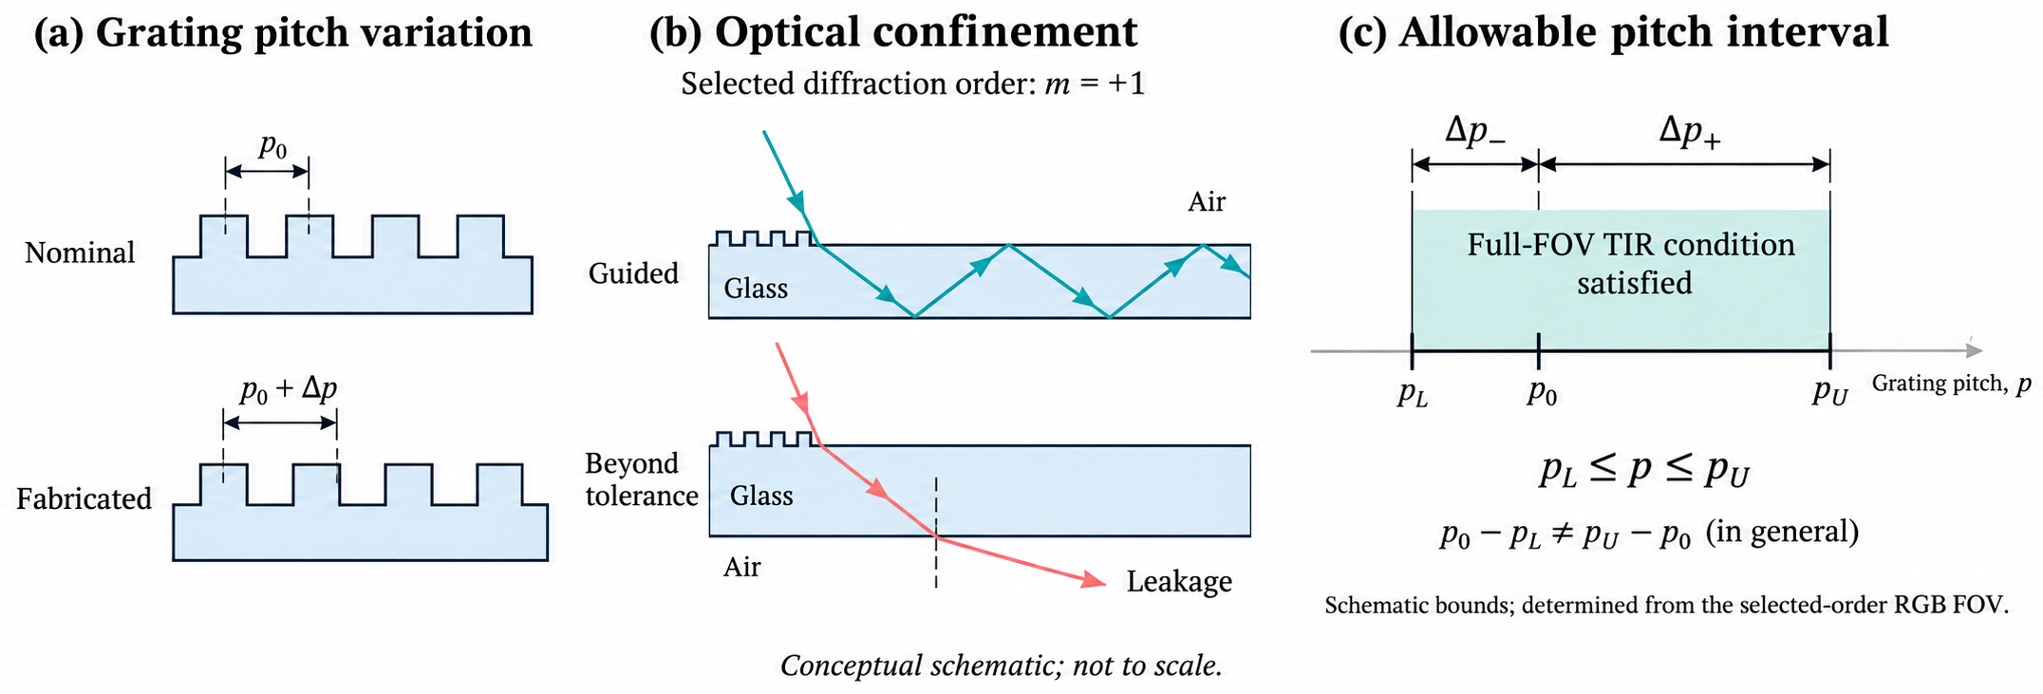
Engineering motivation and physical insight
This simulation framework links optical design and fabrication by identifying asymmetric grating pitch tolerance limits and translating them into symmetric ± pitch specifications for process control and acceptance
Process specifications
Understanding optical behavior
Use an AR waveguide input coupler as a
case study to link pitch deviations with
diffraction angles and guiding conditions.
Provide quantitative results to bridge process, optical design, and simulation teams
Examine the coupled effects of grating pitch, wavelength, and glass refractive index.
Clarify physical mechanisms governing field clipping and angular sensitivity to guide design decisions
Grating pitch variation
Optical confinement
Allowed pitch interval
ex: m = +1
ex: m = +1

Slide 3
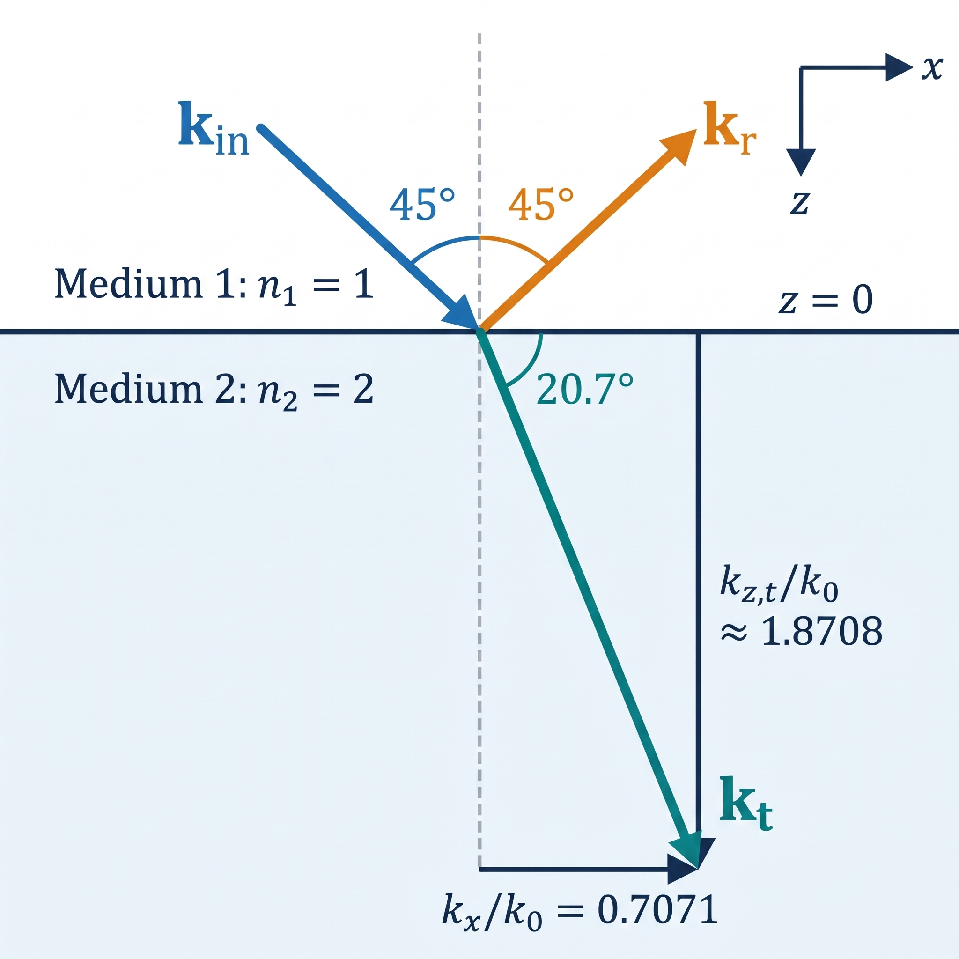
Mechanism – Maxwell Boundary Conditions and Phase Matching
For electric boundary condition (B.C.), tangential wavevector components are conserved across a planar interface, while the normal component adjusts to satisfy the dispersion relation
B.C. I : E_{in,∥} + E_{r,∥} = E_{t,∥}
Maxwell’s boundary conditions require continuity of the total tangential electric field across the interface.
B.C. II : k_{x,in} = k_{x,r}= k_{x,t} k_{y,in} = k_{y,r} = k_{y,t}
For plane waves at a uniform interface, the spatial
factors exp[i(kₓx + k_{y}y)] must match everywhere along the boundary, while complex amplitudes can differ
k_{z}² = (nk₀)² − kₓ² − k_{y}²
Changing n scales the total wavevector ( k = nk₀), causing k_{z} to adjusts while tangential components k∥ remain conserved
Tangential wavevector conservation (k_{x}) dictates diffraction and total internal reflection (TIR) conditions.
Example: θin = 45°, θt = 20.7048°. At the interface, kz,r = −kz,in.

Slide 4
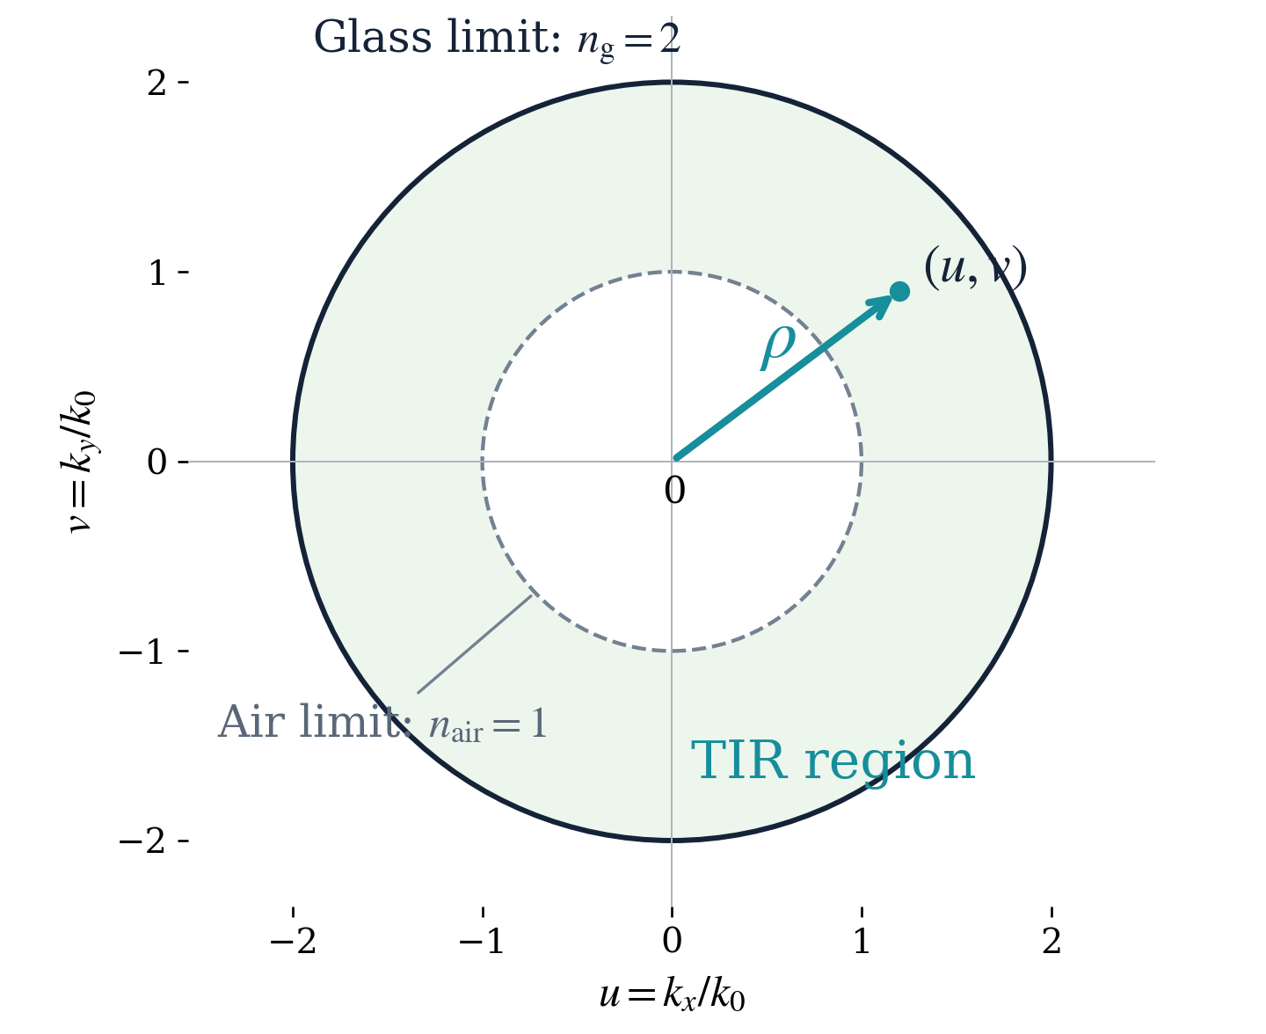
Mechanism – Total Internal Reflection (TIR) and FOV
Mapping the guided wavevector in k-space evaluates whether the light, once diffracted into the substrate, maintains total internal reflection (TIR) upon its next bounce at the glass–air boundary
TIR condition: n_{air} < ρ < n_{g}
A k-space point (u,v) represents a light direction
u = k_{x}/k₀, v = k_{y}/k₀, k₀ = 2π/λ₀
k_{z}² = (nk₀)² - (k_{x}² + k_{y}²) = k₀² (n² - ρ²)
Ex:
for n_{g} = 2
1 < ρ < 2
Boundary conditions define the guiding region
Air limit (TIR condition) : ρ > n_{air}
  Prevents leakage into air and forces an evanescent field at the surface
  k_{z,air} becomes pure imaginary (evanescent)
Glass limit (core propagation) : ρ < n_{g}
  Ensures physical propagating modes inside the glass core
  (prevents cut-off)
Outside outer circle (waveguide cut-off) : ρ > n_{g}
  k_{z,g} becomes pure imaginary → diffracted field decays evanescently at surface
  No propagating ray exists inside glass → causes FOV clipping
k_{z,air}² = k₀²(n_{air}² - ρ²) < 0
n_{g} : glass refractive index
n_{air} : air on both sides
ρ : the distance from the origin to a field point
θ : measured from the surface normal.
(At fixed glass index, larger ρ means larger θ)
k_{z,g}² = k₀²(n_{g}² - ρ²) > 0 → k_{z,g} ∈ ℝ (Propagating)

Slide 5
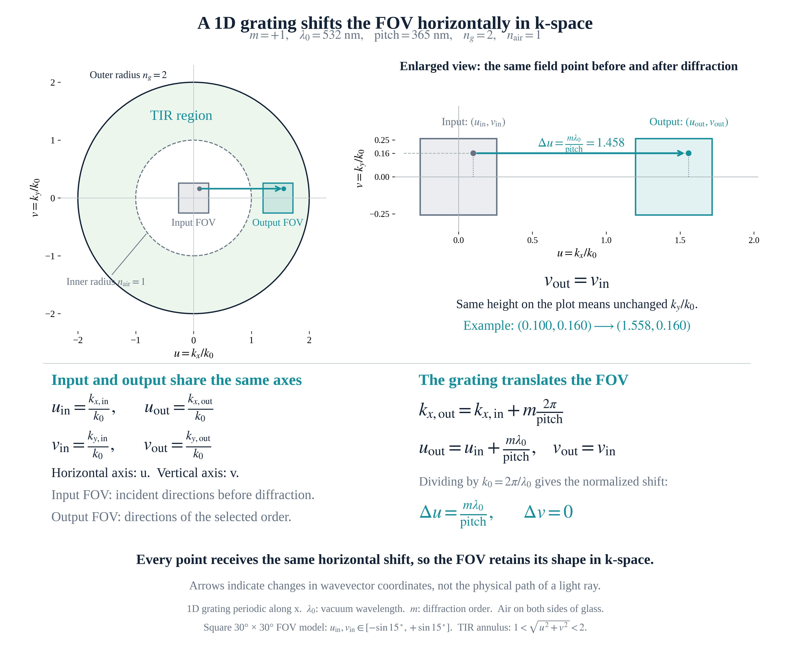
Design Evaluation – Mapping the FOV in k-space
Each point (u, v) represents a propagation direction through its normalized in-plane wavevector
The grating pitch is engineered to impart a precise in-plane momentum shift (Δu = mλ₀/pitch), translating the non-guided input FOV entirely into the TIR annular region for lossless substrate propagation
k-vector representation
Input FOV shifting via grating pitch

Slide 6
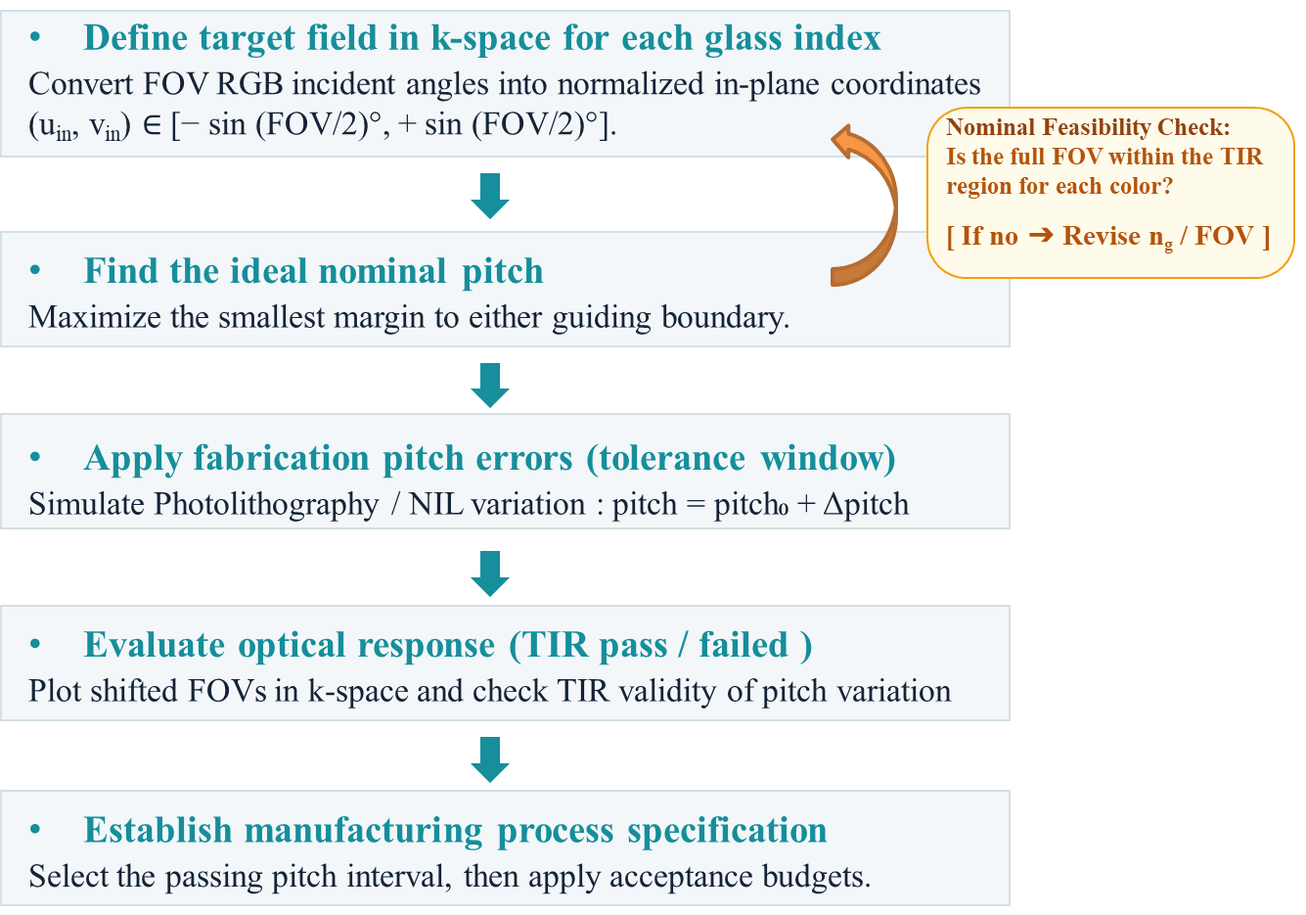
Design Flowchart: From Ideal Pitch to Process Specification
The workflow links full-FOV confinement to an allowable manufacturing pitch range.
Simulation parameters (1D grating)
  n_{g} : 1.5 / 1.8 / 2.0 / 2.2 / 2.4
  RGB : 465 nm / 532 nm / 630 nm
  FOV : 30° × 30°
  Diffraction order : m = -1
Full-field guiding criterion
  Each field (RGB) point must satisfy
  1 < ρ < n_{g}

Slide 7
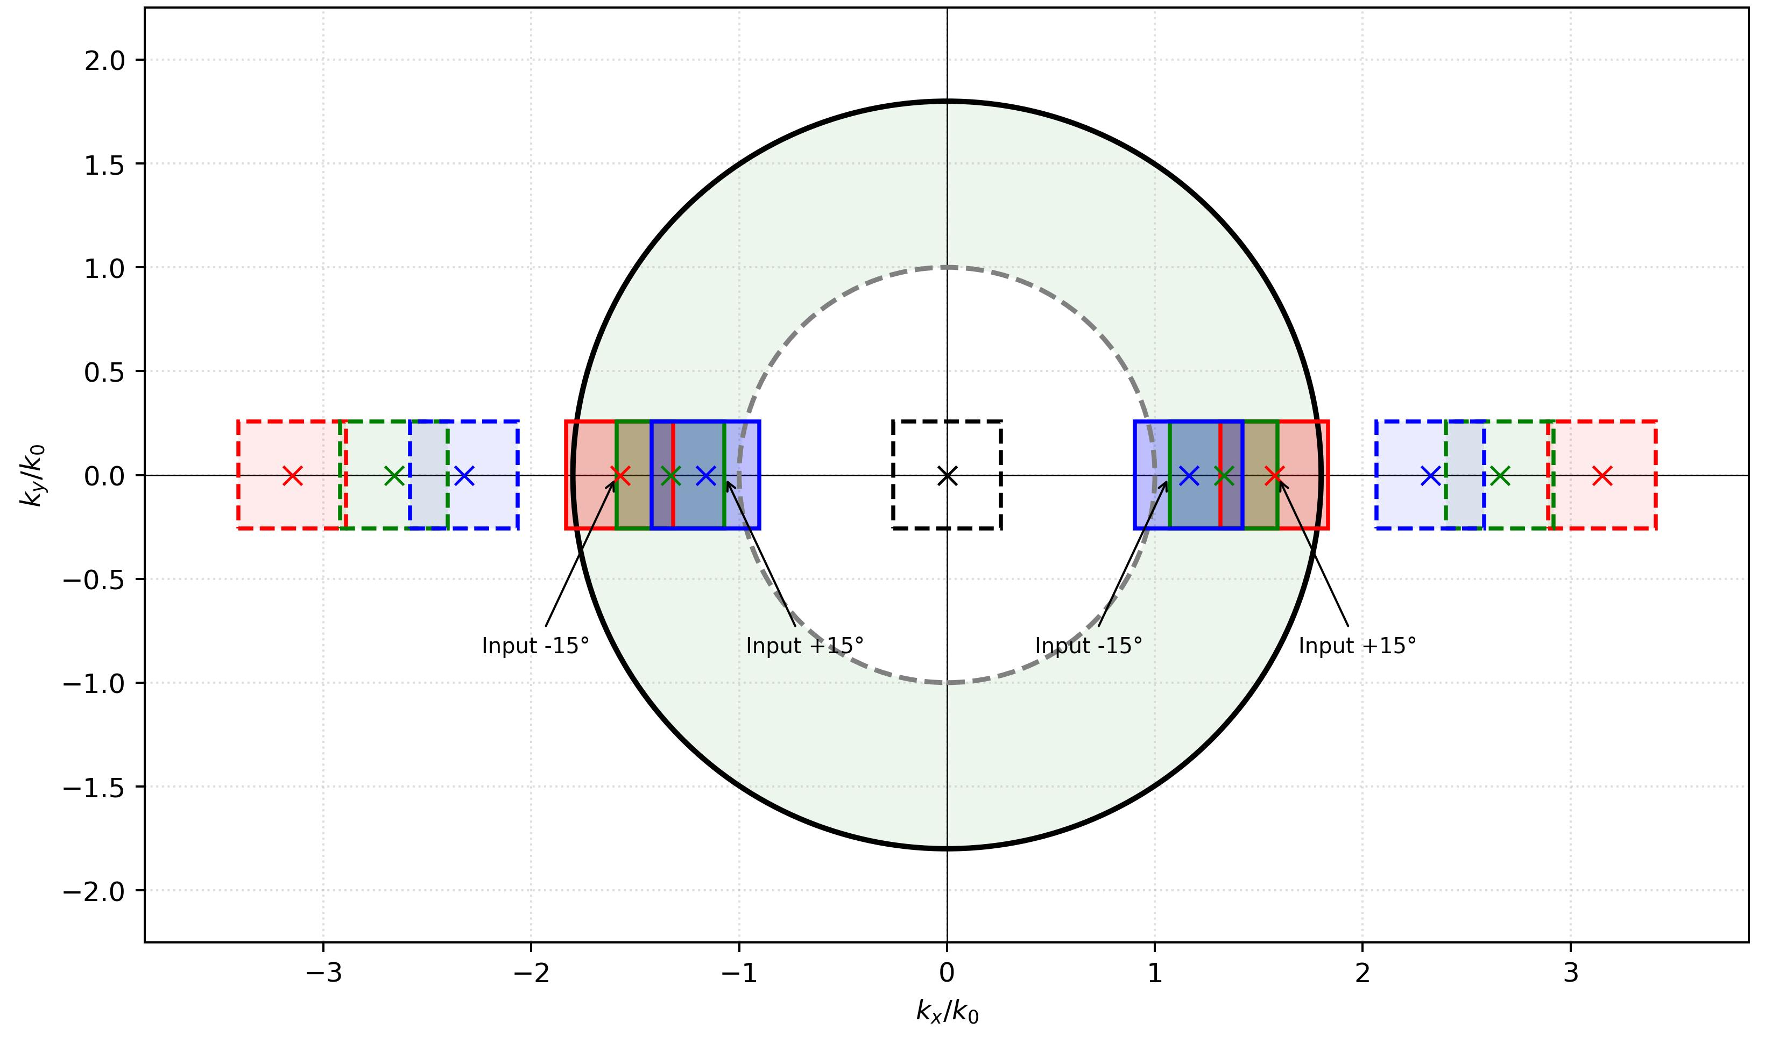
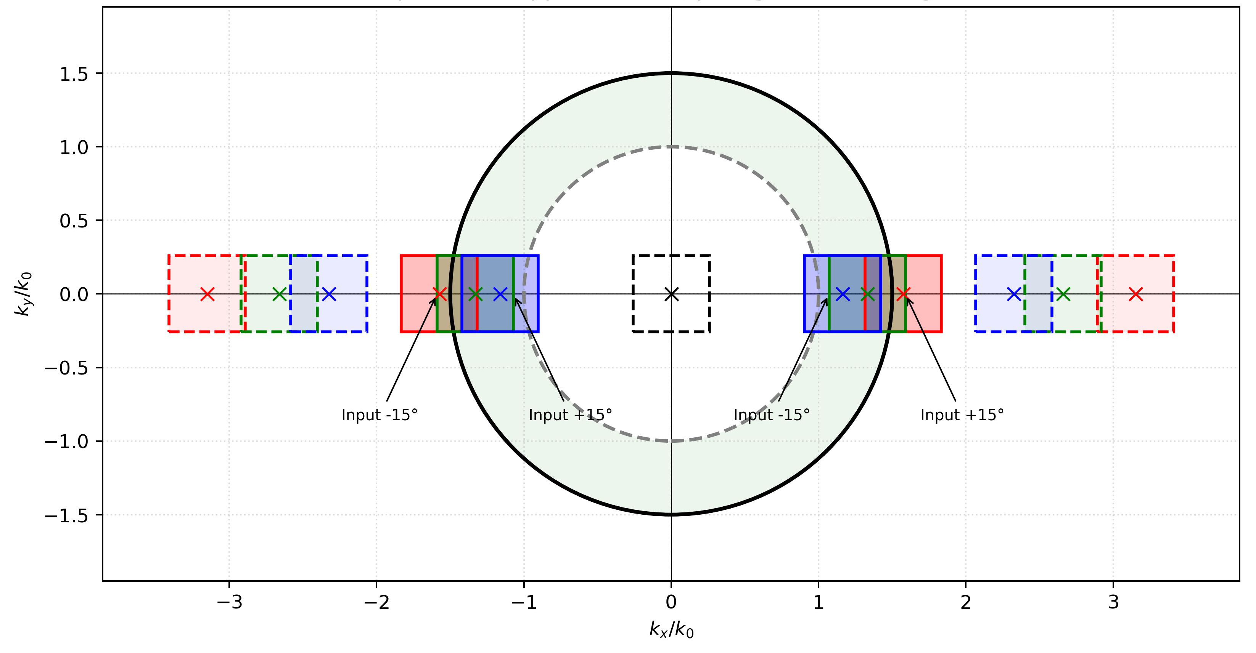
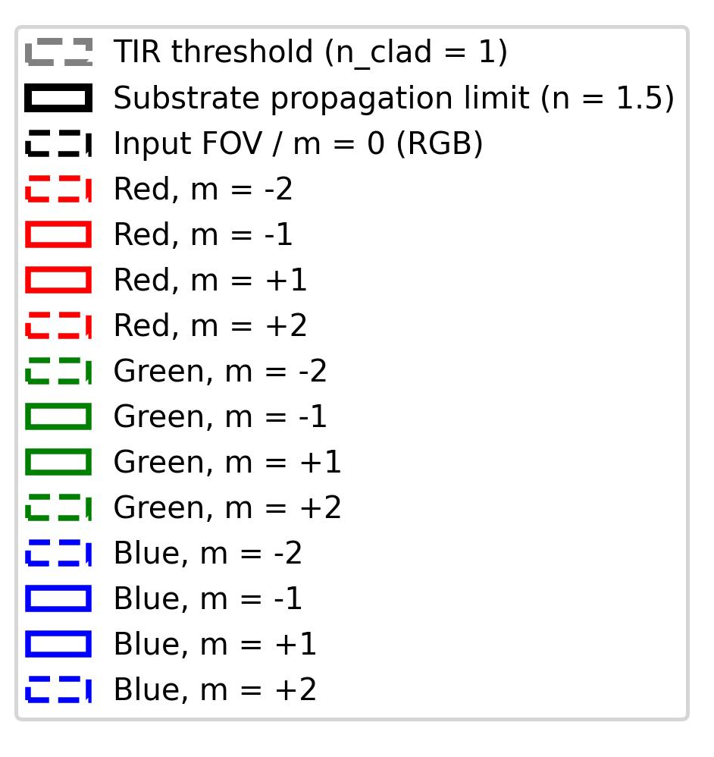
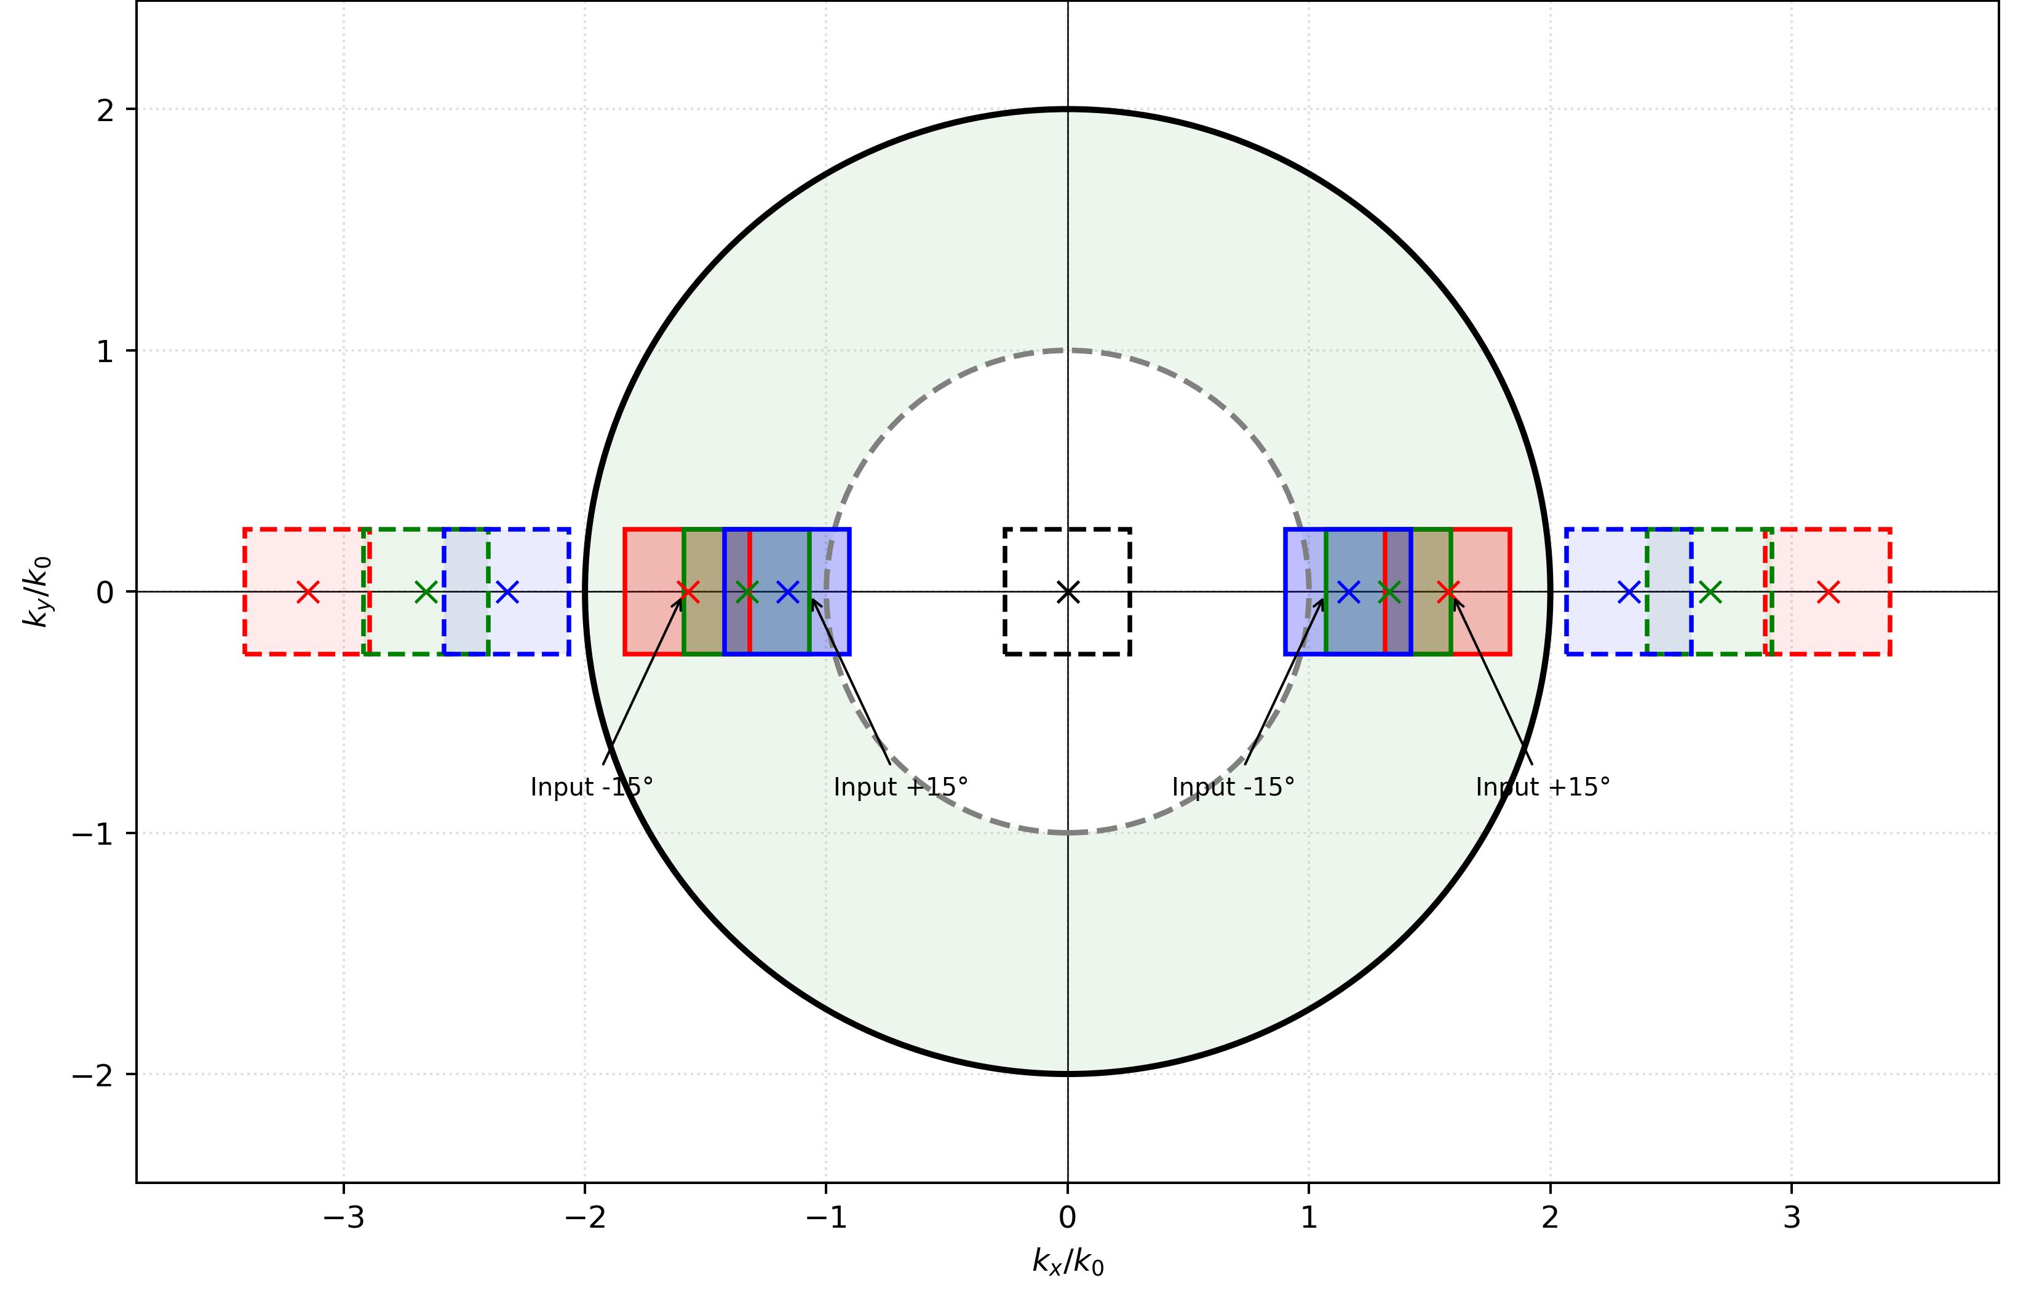
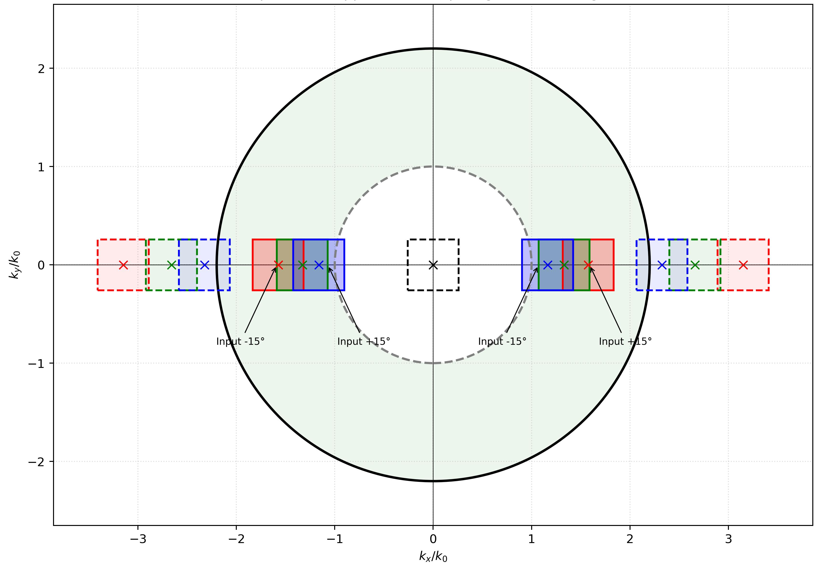
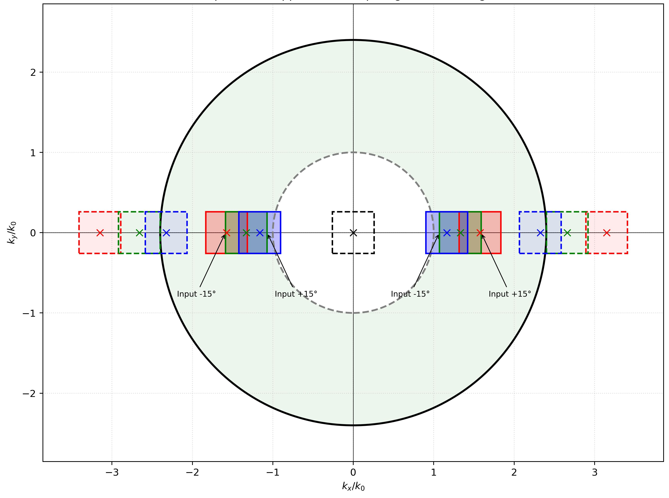
Glass of Different Refractive Indices – TIR Region
Refractive index directly determines the window of FOV
A higher refractive index provides a wider TIR region and accommodates a broader wavelength range
  Greater feasibility (or larger design margin) for a full-color FOV
A key optical drawback of a higher refractive index is that unwanted higher-order diffractions
(e.g. m = ± 2) are more likely to fall into the TIR region
n_{g} = 1.5
n_{g} = 1.8
Simulation parameters (1D grating)
  n_{g} : 1.5 / 1.8 / 2.0 / 2.2 / 2.4
  RGB : 465 nm / 532 nm / 630 nm
  FOV : 30° × 30°
  Pitch : 400 nm
  Diffraction order : m = -1
n_{g} = 2.0
n_{g} = 2.2
n_{g} = 2.4

Slide 8
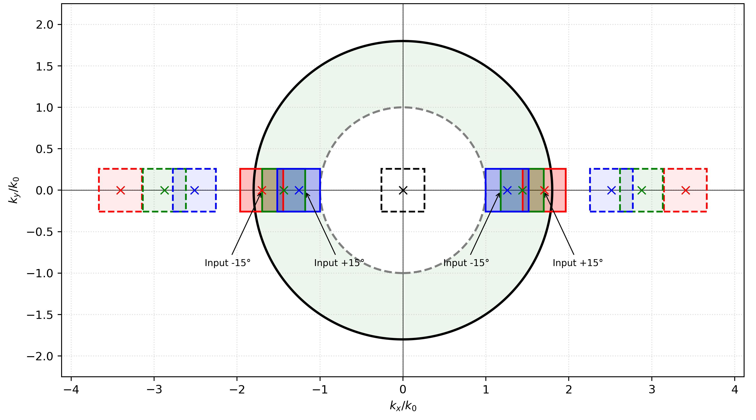

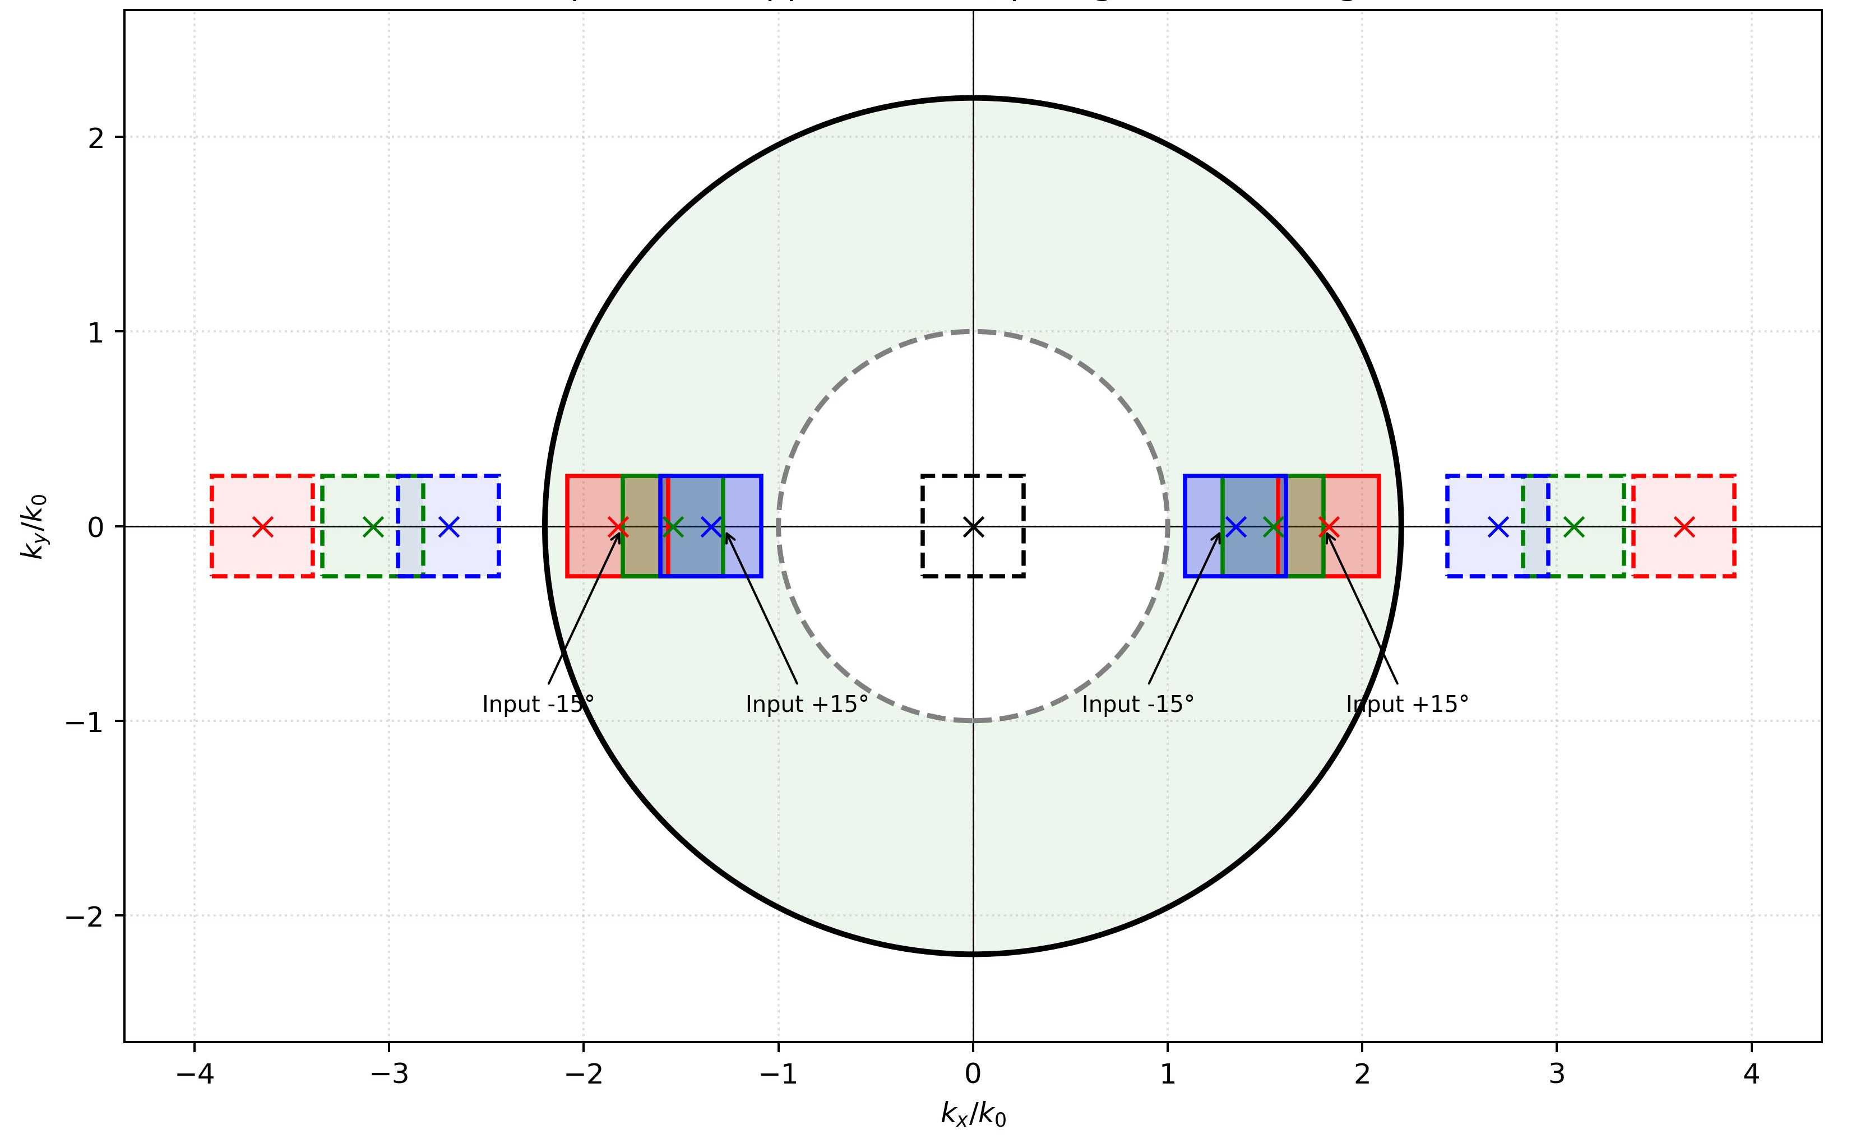
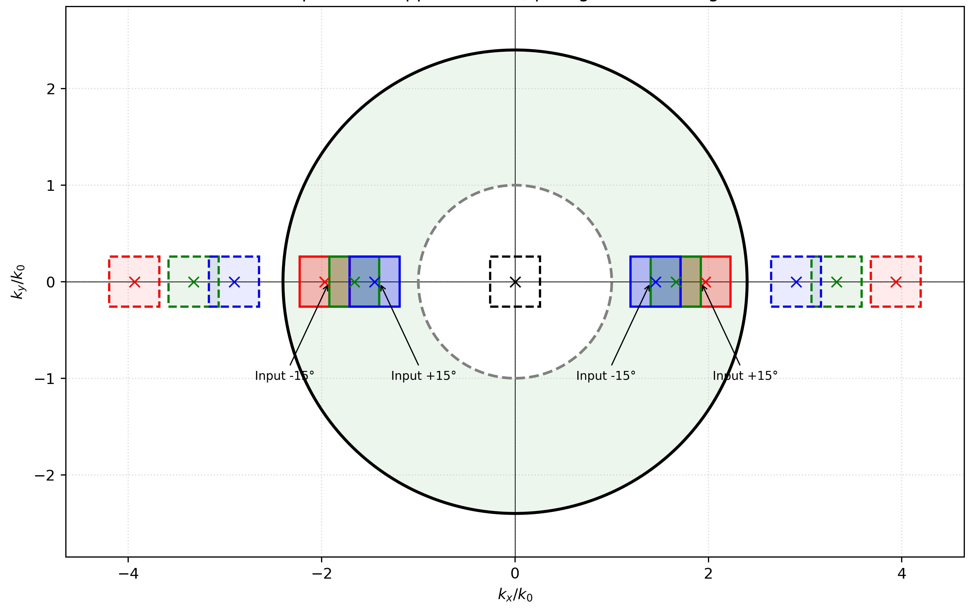
Glass of Different Refractive Indices – Optimal Pitch
The optimal nominal pitch (centering the RGB FOV with maximum margin) decreases as the refractive index increases.
Substrates with n_{g} ≤ 1.8 suffer from FOV clipping due to their narrow TIR regions.
  Lower-index glasses can still support monochromatic display (or narrower spectral bands)
n_{g} = 1.8
Pitch = 360 nm (not full FOV)
n_{g} = 2.0
Pitch = 365 nm
(Full FOV)
Simulation parameters (1D grating)
  n_{g} : 1.5 / 1.8 / 2.0 / 2.2 / 2.4
  RGB : 465 nm / 532 nm / 630 nm
  FOV : 30° × 30°
  Diffraction order : m = -1
n_{g} = 2.2
Pitch = 345 nm
(Full FOV)
n_{g} = 2.4
Pitch = 320 nm
(Full FOV)

Slide 9
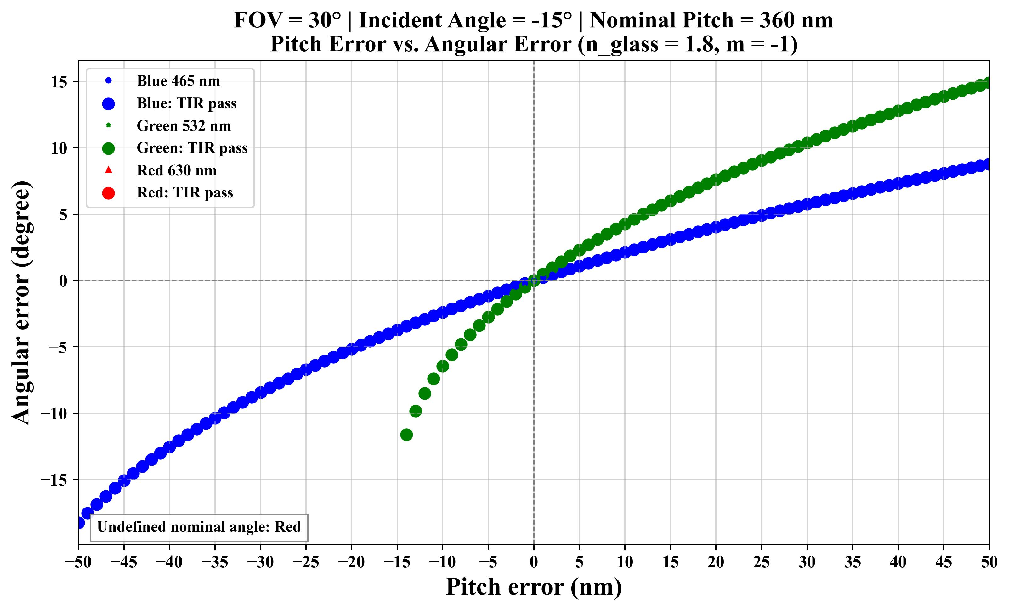
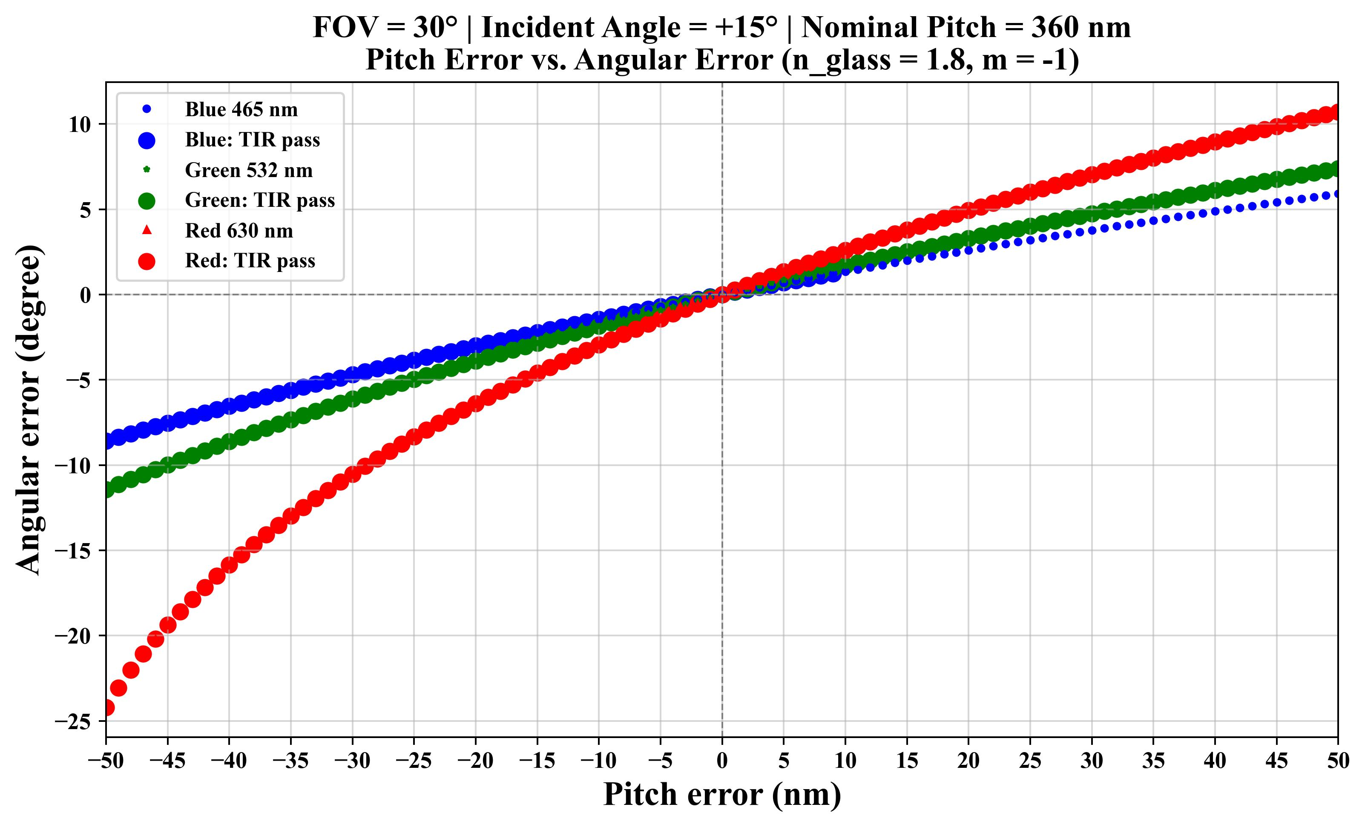
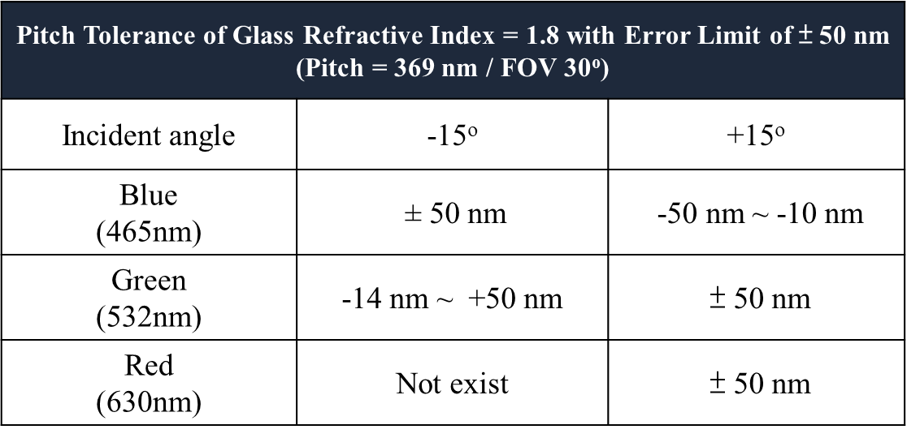
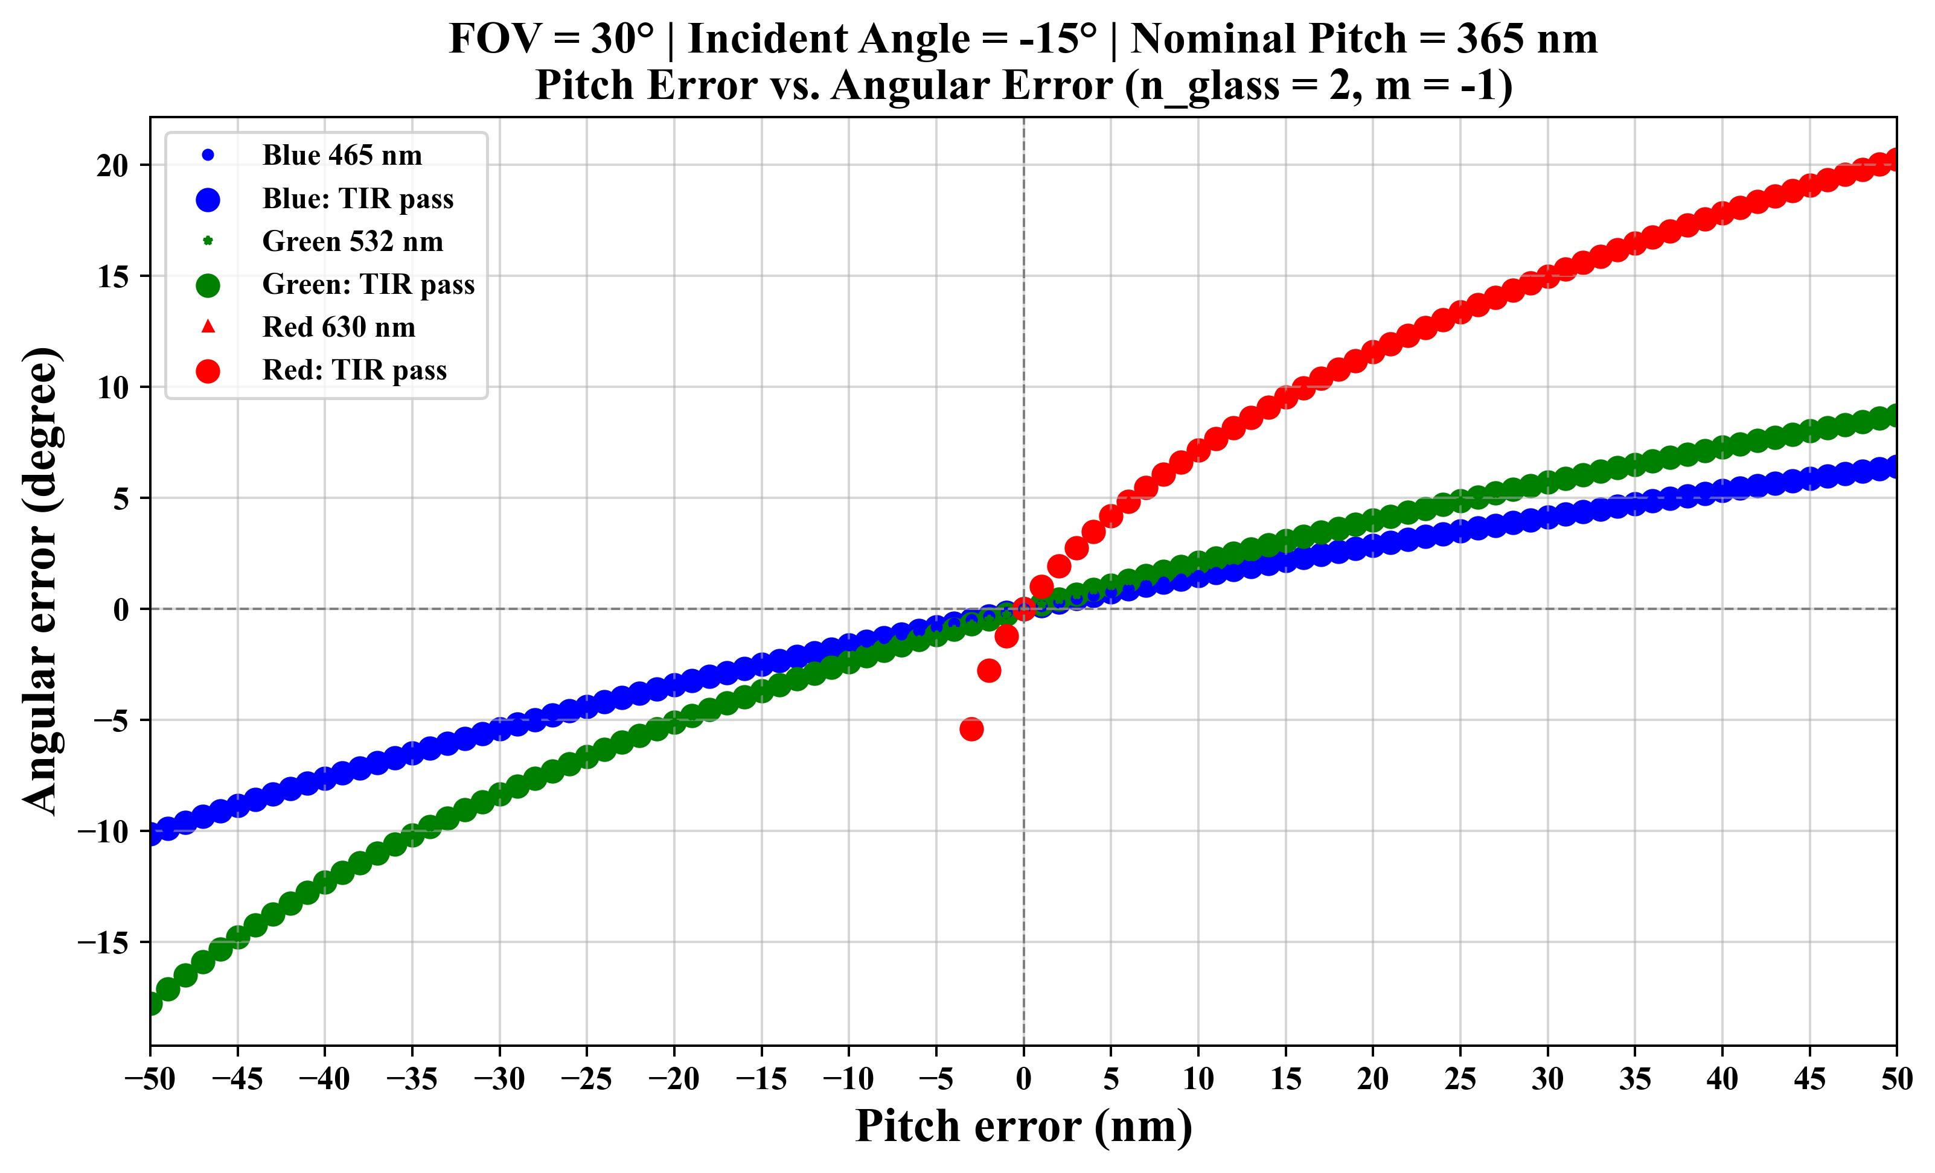
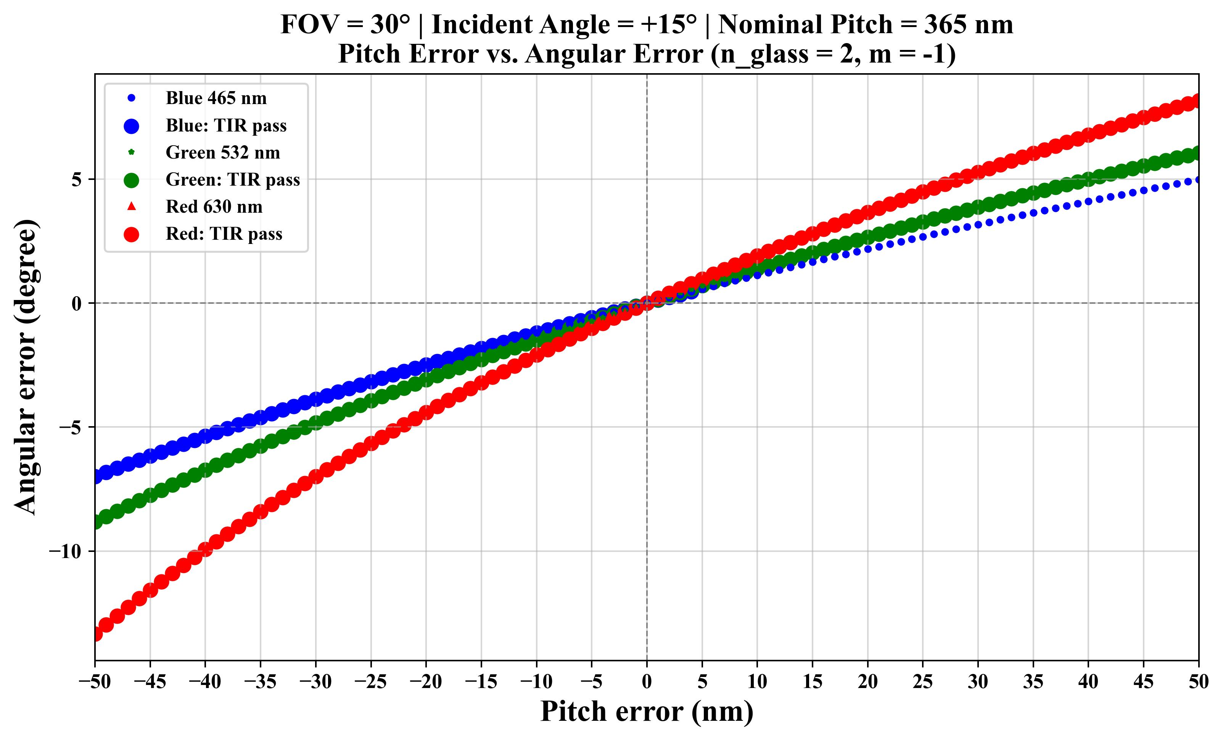
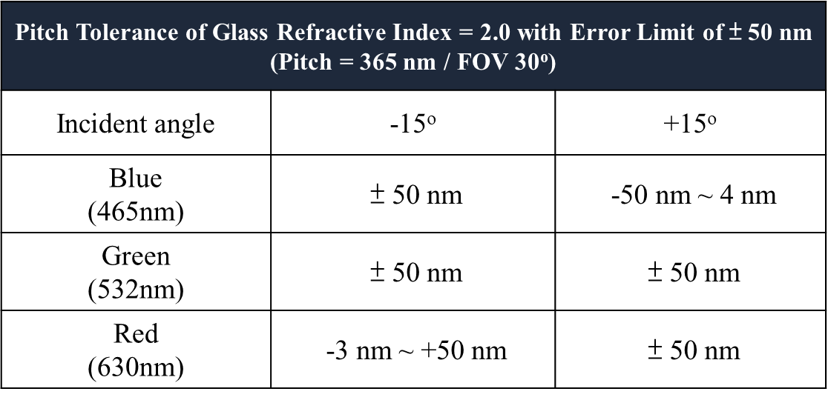
Glass of Different Refractive Indices – Pitch Tolerance (n_{g} = 1.8 / 2.0)
To evaluate full-field optical confinement for a 30º FOV, simulations test the boundary incident angles (±15º) where larger solid dots indicate that the guided ray satisfies the TIR condition

Slide 10
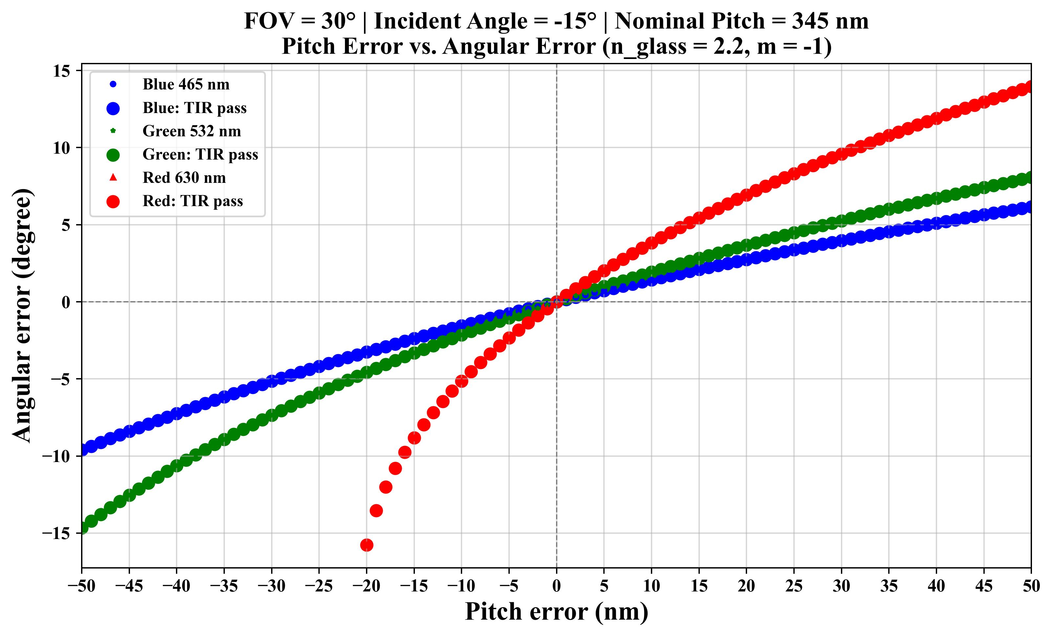
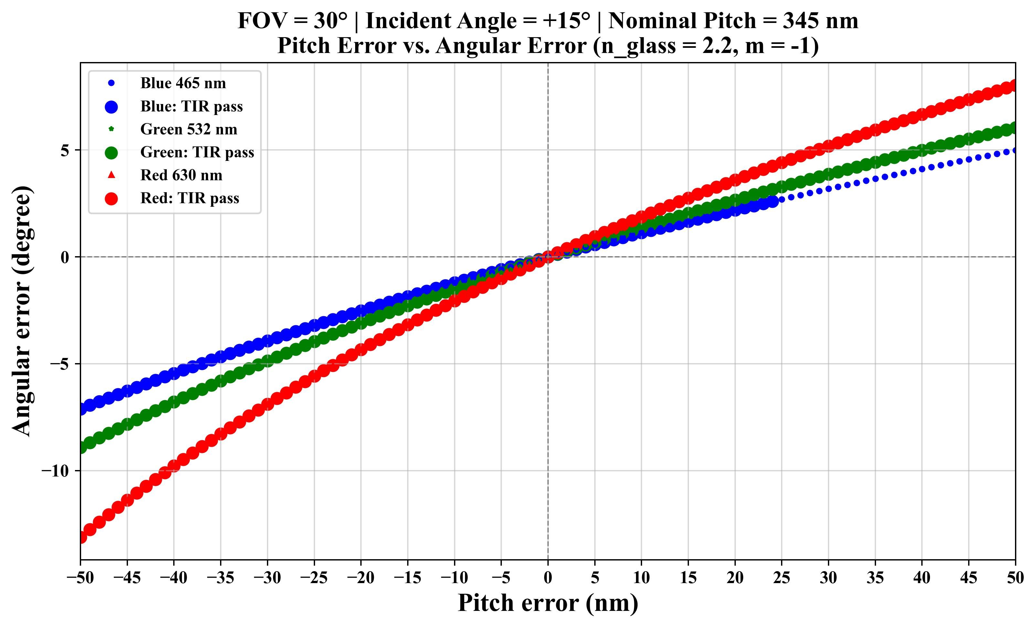
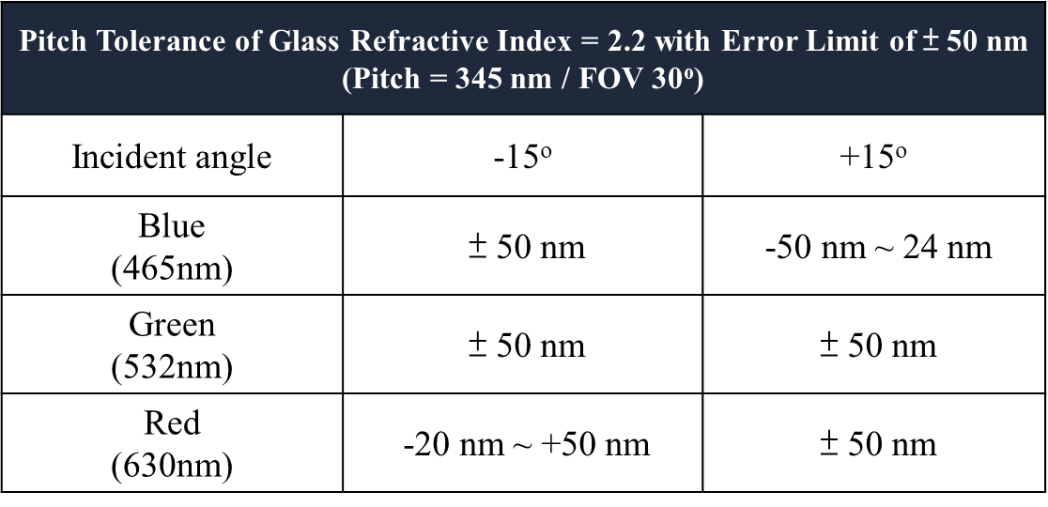
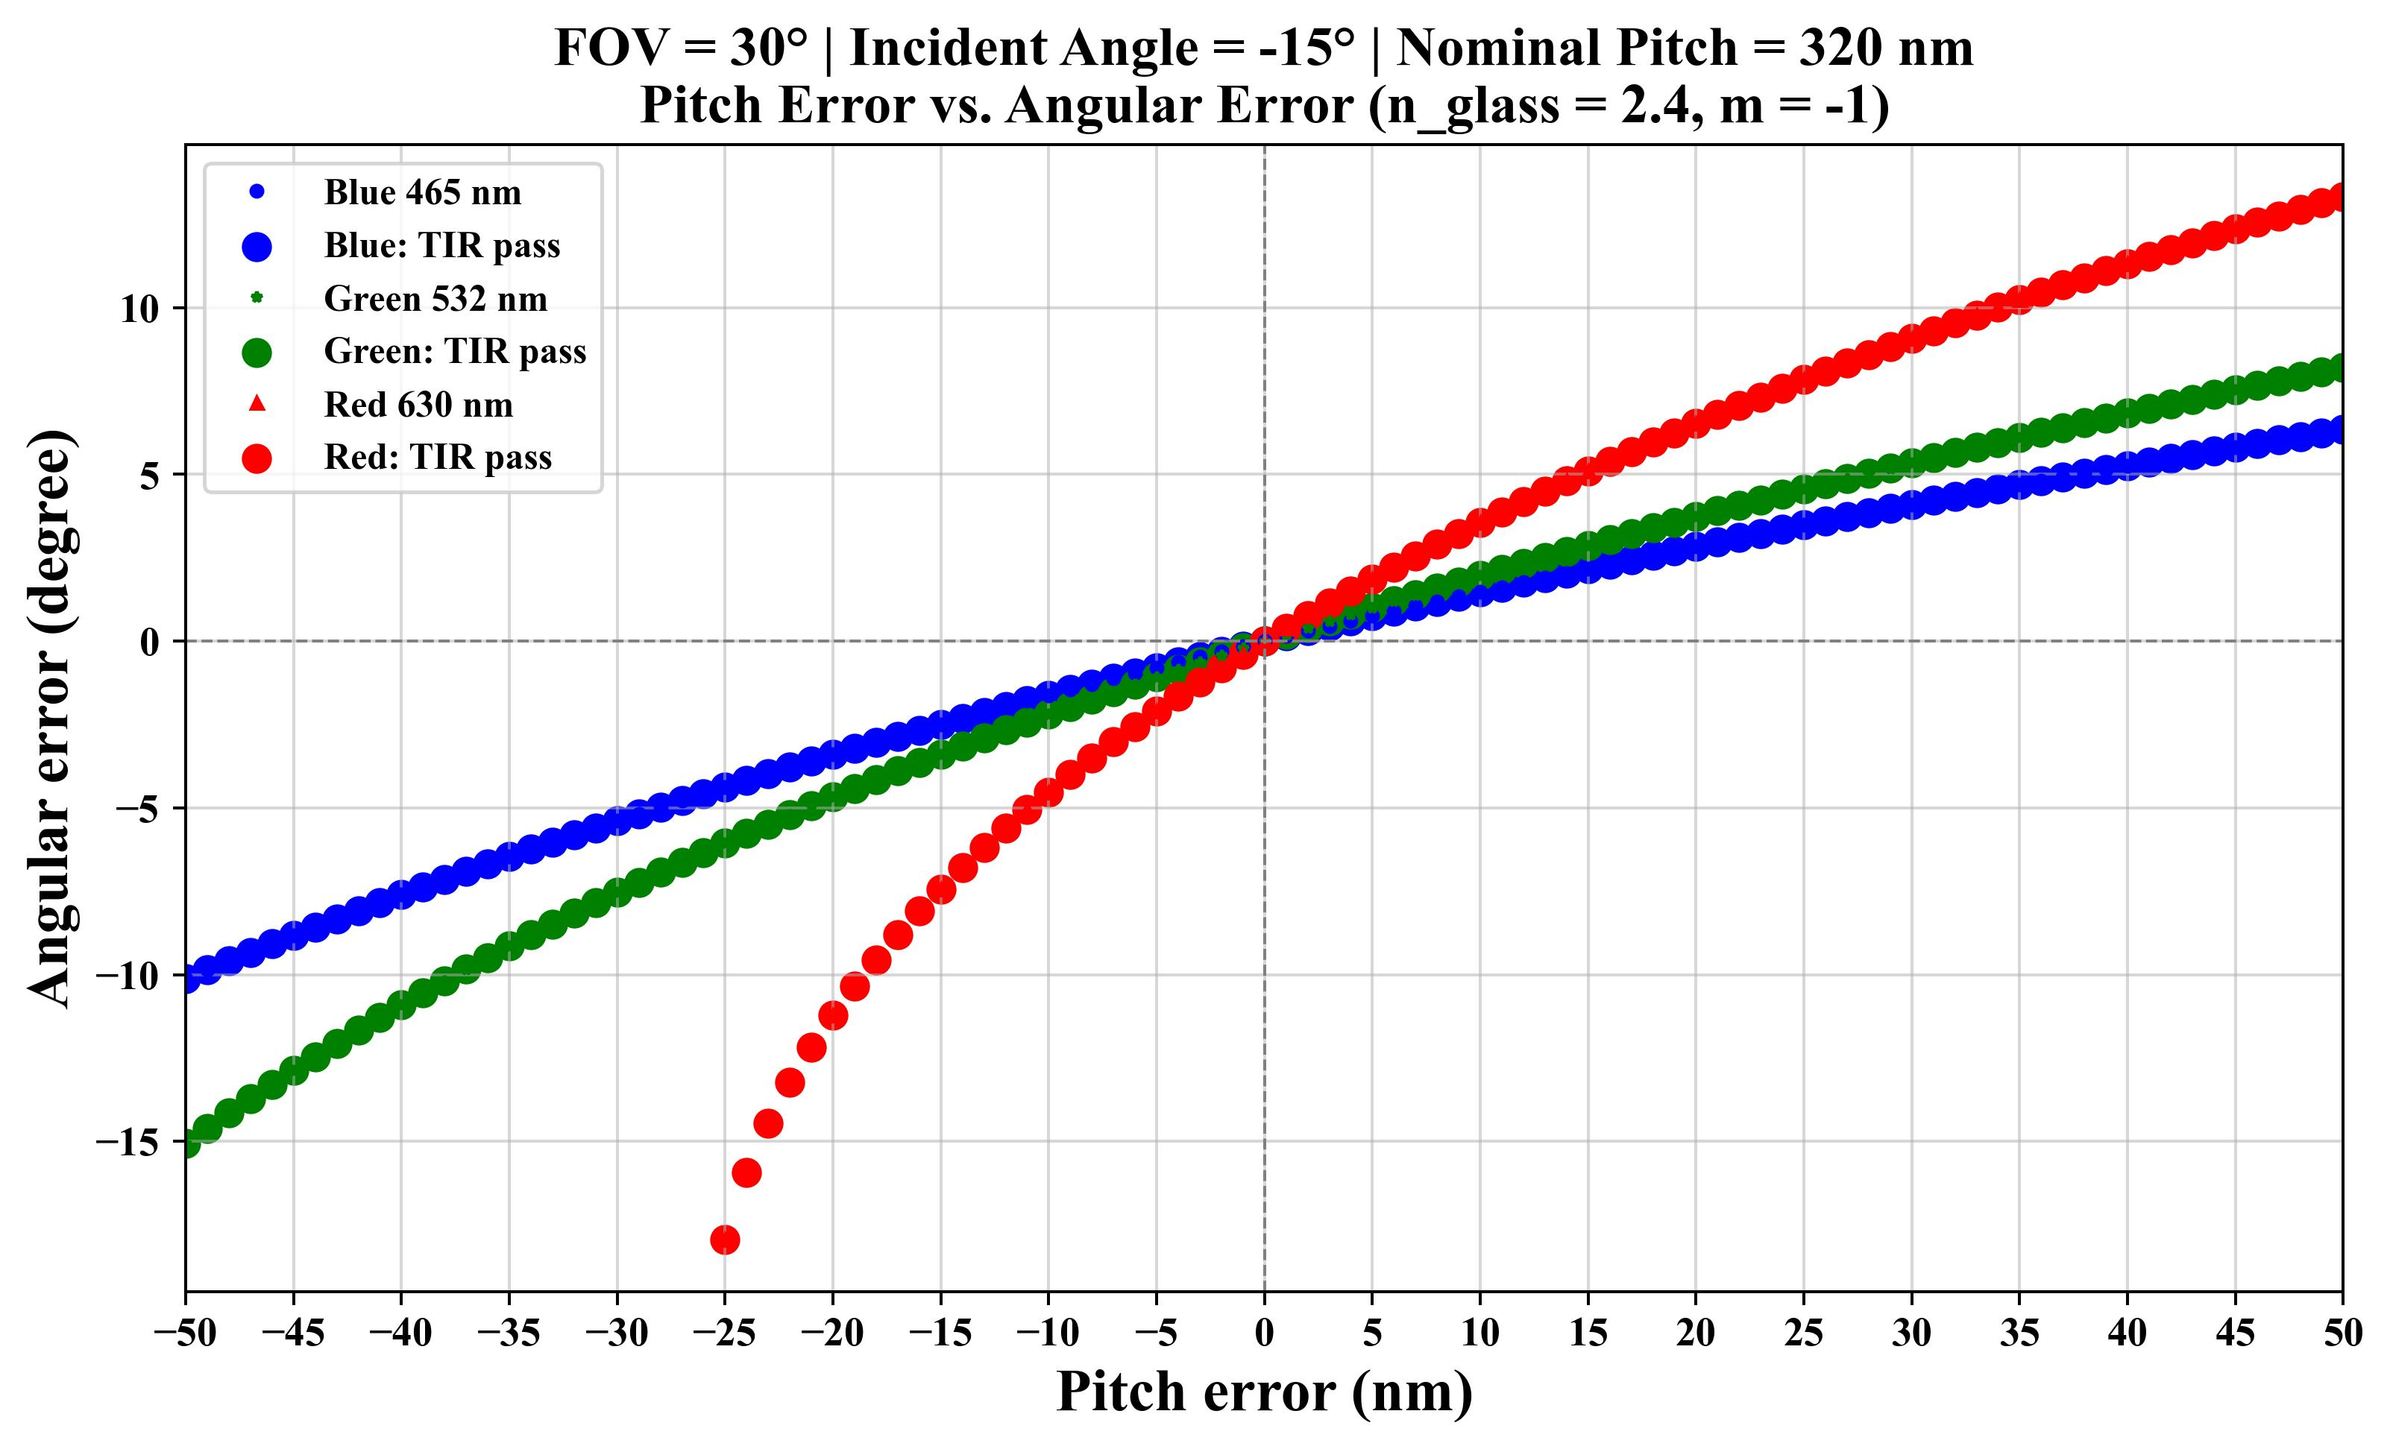
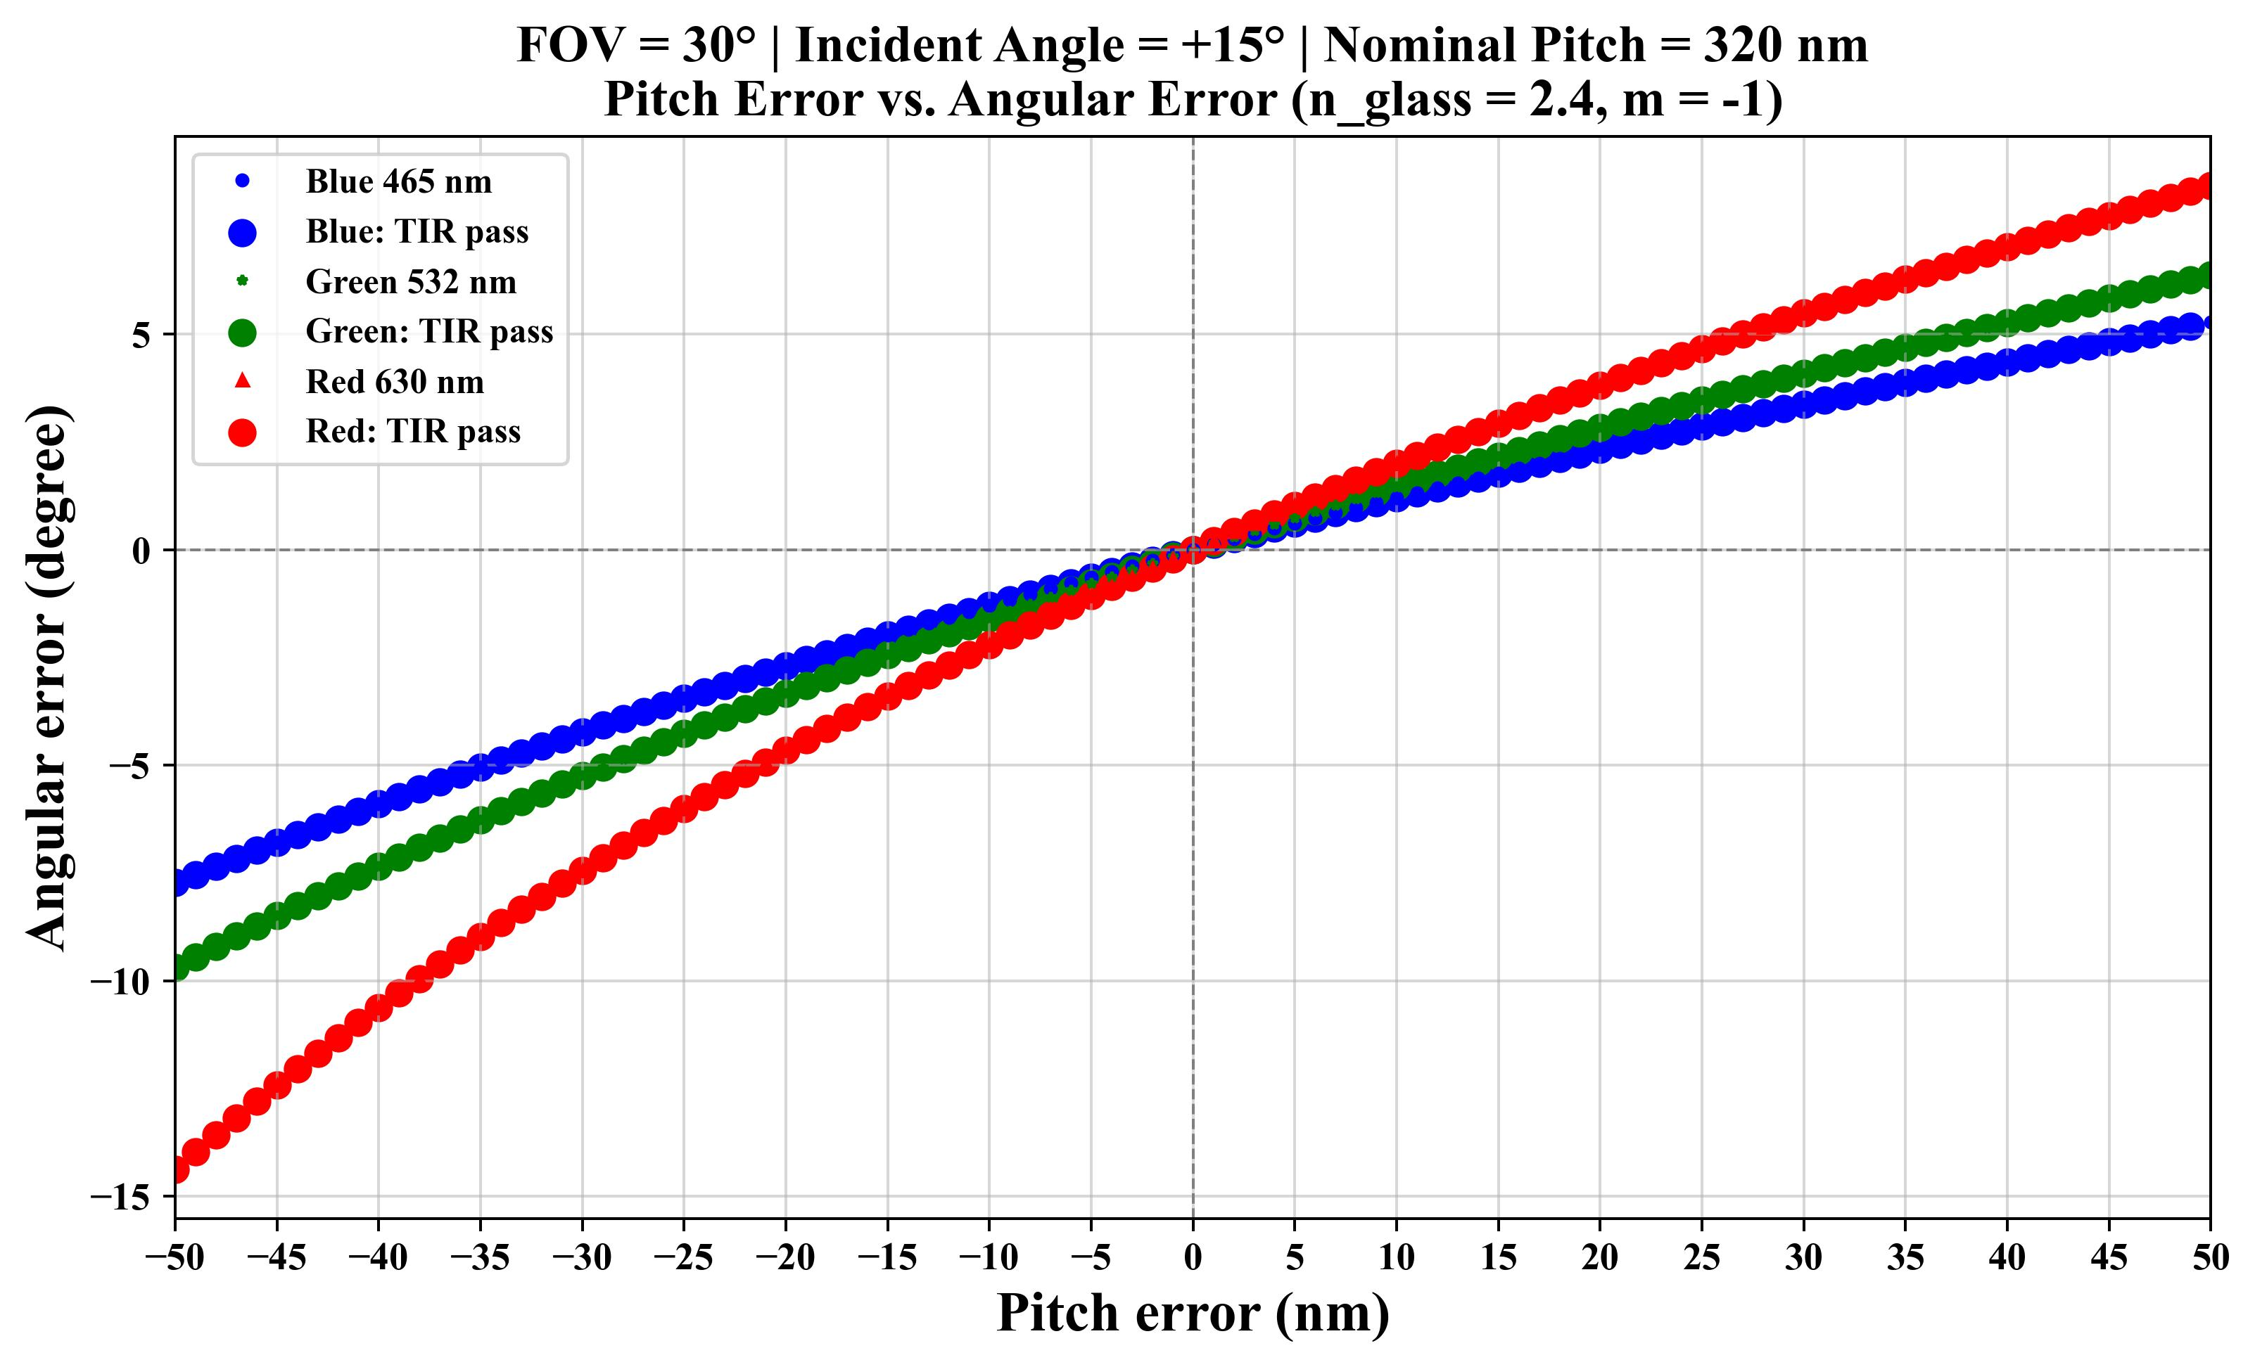

Glass of Different Refractive Indices – Pitch Tolerance (n_{g} = 2.2 / 2.4)
To evaluate full-field optical confinement for a 30º FOV, simulations test the boundary incident angles (±15º) where larger solid dots indicate that the guided ray satisfies the TIR condition

Slide 11
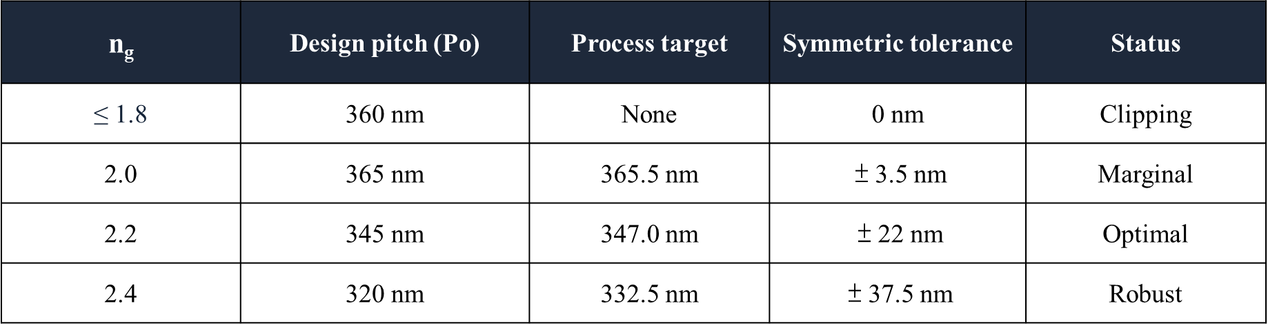
Overall Conclusion
Re-centering the allowable pitch interval converts asymmetric optical margins into a symmetric fabrication specification
1. Asymmetric optical tolerance
2. Process-oriented target pitch
The nominal pitch p₀ maximizes the minimum margin
to the k-space circle boundaries.
p_{target} = (p_{L} + p_{U})/2
Δp_{sym} = (p_{U} − p_{L})/2
Red (630 nm): cut-off limits negative pitch error
near the −15° incident-angle boundary.
Re-center [p_{L}, p_{U}] to use the full feasible interval
as p_{target} ± Δp_{sym} for fabrication.
Blue (465 nm): air leakage limits positive pitch error
near the +15° incident-angle boundary.
The upward shift is +0.5 to +12.5 nm:
+2 nm for n_{g} = 2.2 and +12.5 nm for n_{g} = 2.4.
At p₀: symmetric budget = min(Δp₋, Δp₊).
For a centered ±3σ budget: 3σ ≤ Δp_{sym}.
3. Quantitative summary and material selection
FOV: 30° × 30° RGB: 465 / 532 / 630 nm Diffraction order: m = -1

